Slide 1

Bangladesh Army University of Science & Technology (BAUST), Saidpur
Department : Computer Science & Engineering
Course Code : CSE2200
Course Title : Software Development Project II
Submitted By :
Submitted To :
Student Name : Md. Rageeb Intisar Polok
ID : 180201100
Batch : 8th
Level : 2 Term : II
Section : B
Date of Submission : 29-11-2020
Teacher Name : MD. Toukir Ahmed
Designation : Lecturer

Slide 2
Student Database
This Project is designed to help tutors to store student's necessary information. This can help teacher to
1. Collect attendance of every batches he takes class,
2. Store students mark of particular examinations,
3. View student's information (regarding course),
4. Calculate students necessary marks easily,
5. Offers password security to the stored data,
6. Update data at any moment.

Slide 3
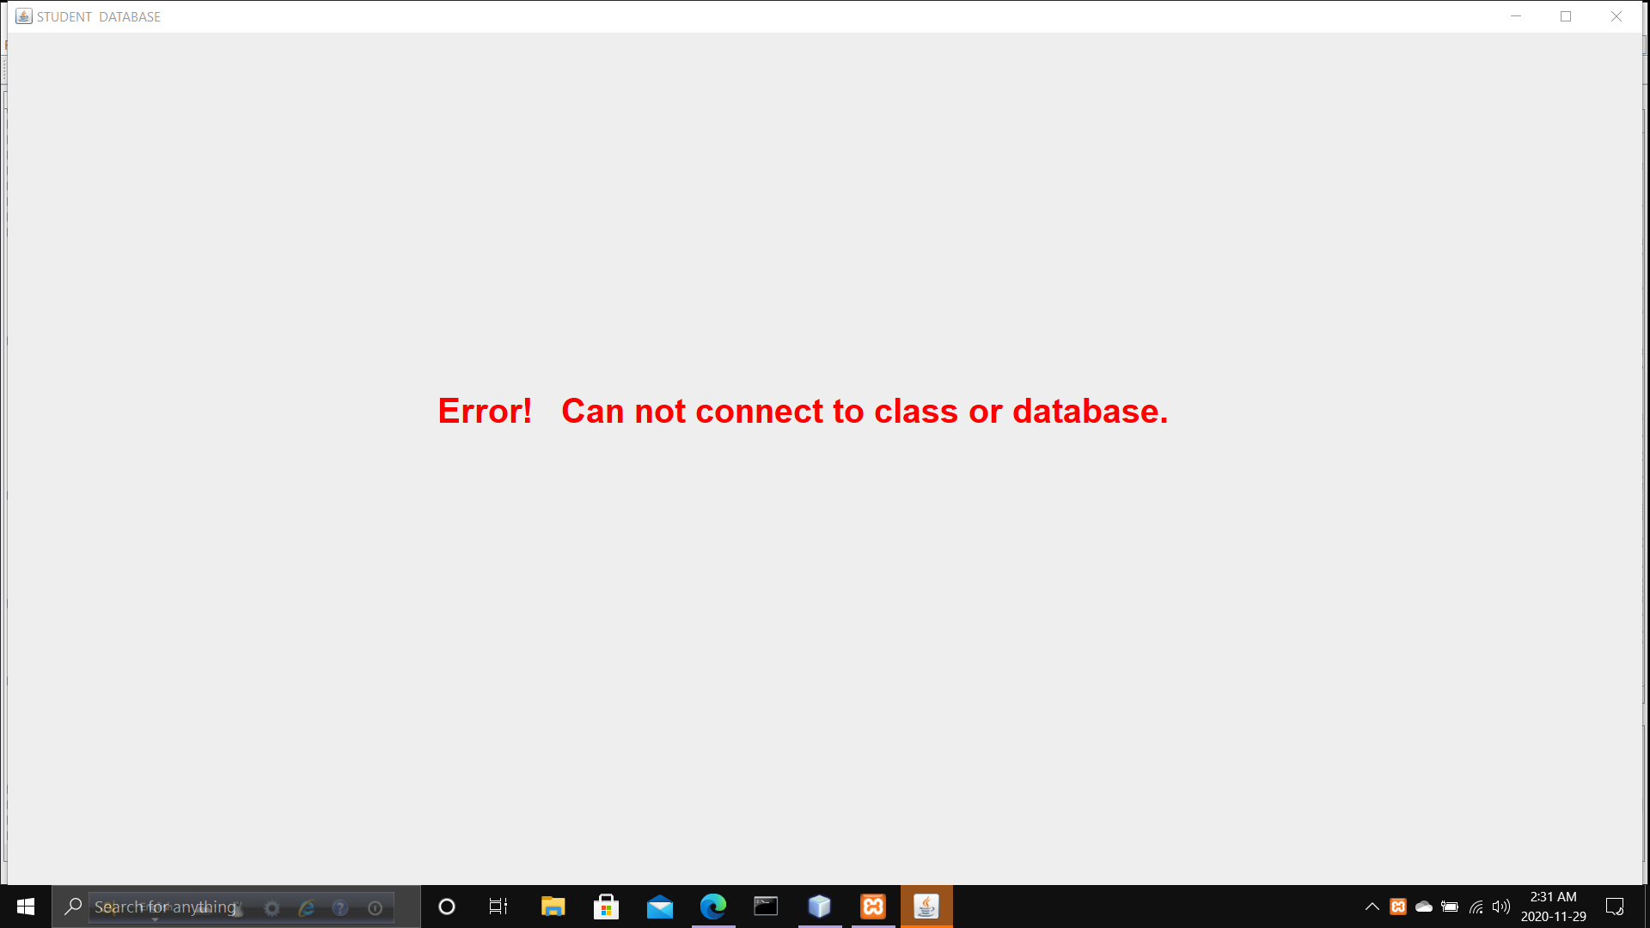
It requires MySQL library and database connection
If it fails to connect to Library or class regarding MySQL, It will warn about it. It is needed to connect library or database and re-open the application again.

Slide 4
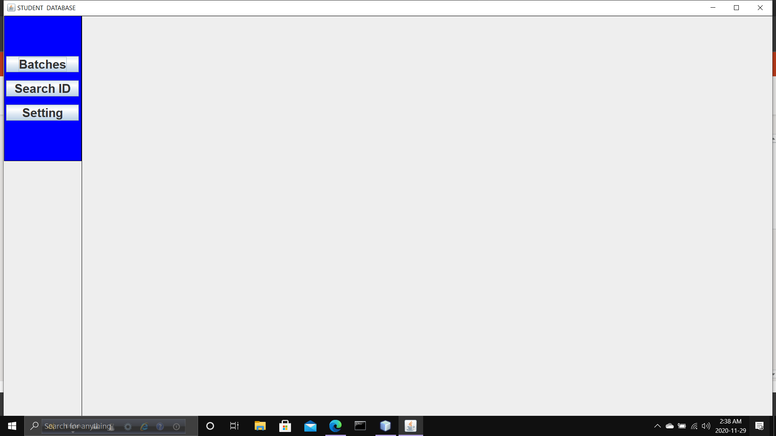
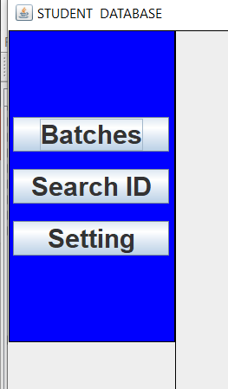
Once connected to class It will display three options. Batches, Search ID and Setting.

Slide 5
Button 'Batches' : To perform some task on a batch. Offers list of the added batches to perform tasks and also offers option to add batch.
Button 'Search ID' : To view stored information of an user-entered id. But updating information is not supported in this option.
Button 'Setting' : To set Password, remove Password, reset everything, this option can be used.

Slide 6
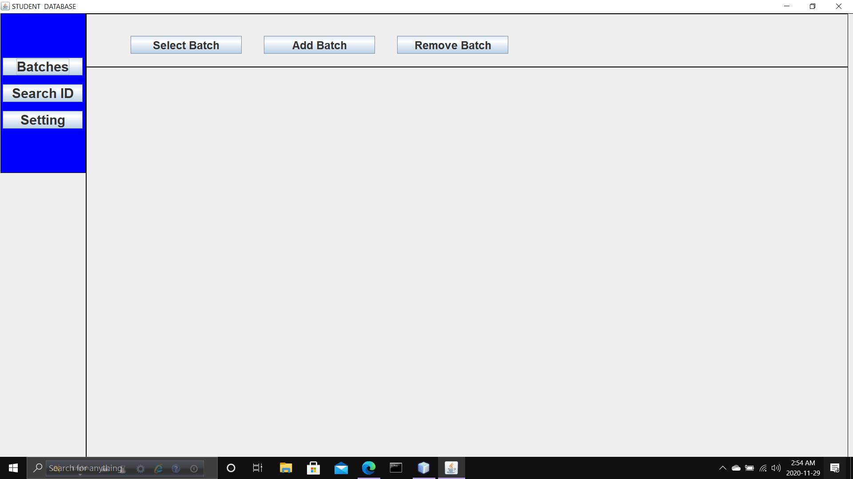
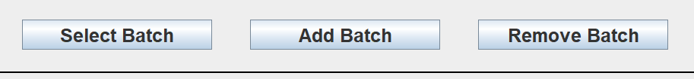
Inside 'Batch' button three options are available. 'Select Batch', 'Add Batch' and 'Remove Batch'.

Slide 7
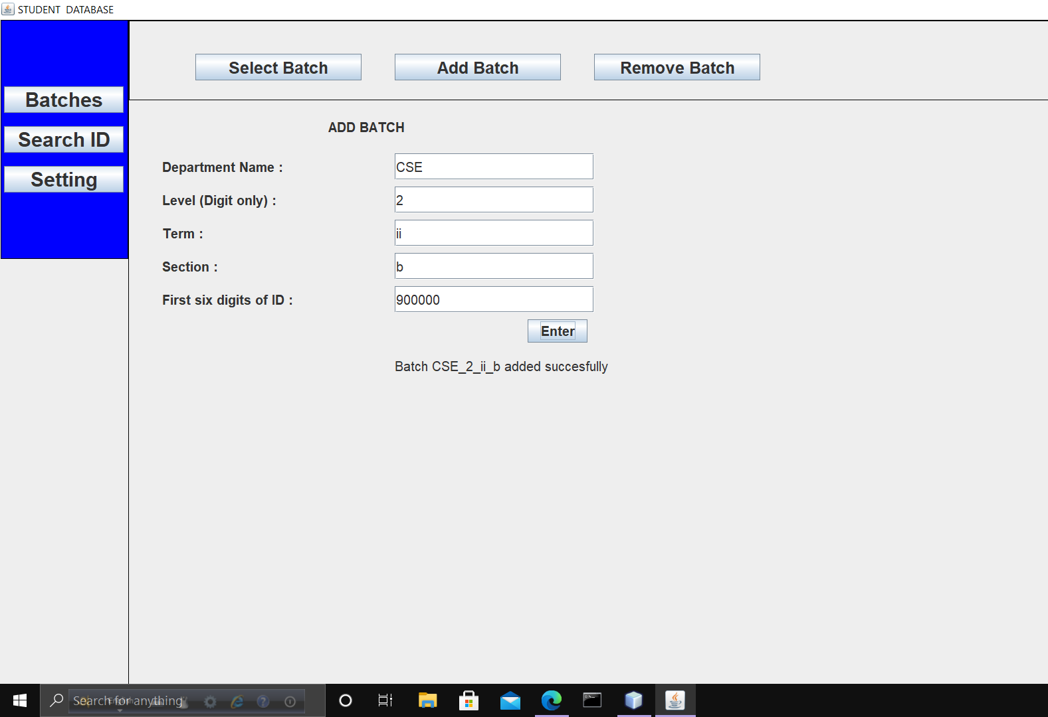
Inside 'Add Batch' button, 5 JTextFields are shown. It is needed to fill up all of those. Cause naming new batch depends on these information.
[ Last JTextField might be little bit confusing. That is first six digits of most of the students id. That might be effective if that project is upgraded later.]

Slide 8
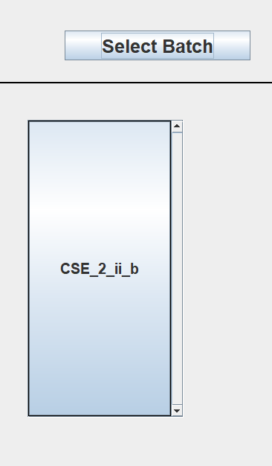
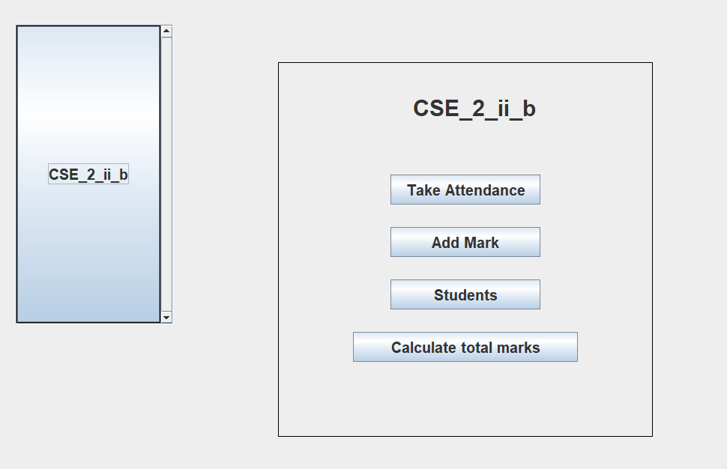
Once a batch is added it can be seen in 'Select Batch' option. Once clicked that batch, it will display some other options.

Slide 9
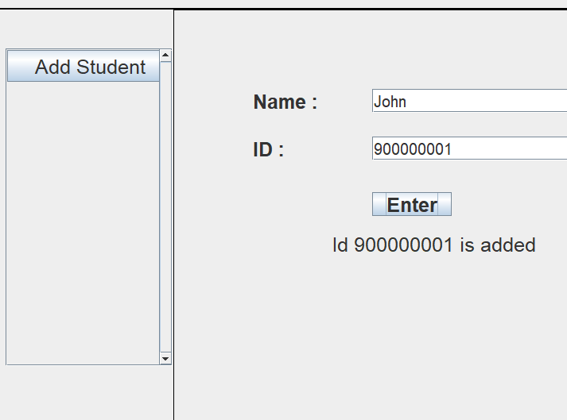
Inside 'Students' button a list will be seen if there is any student added with a 'add student' button. That will help to add student. If it is tried to add multiple student with same id, it will not allow that.

Slide 10
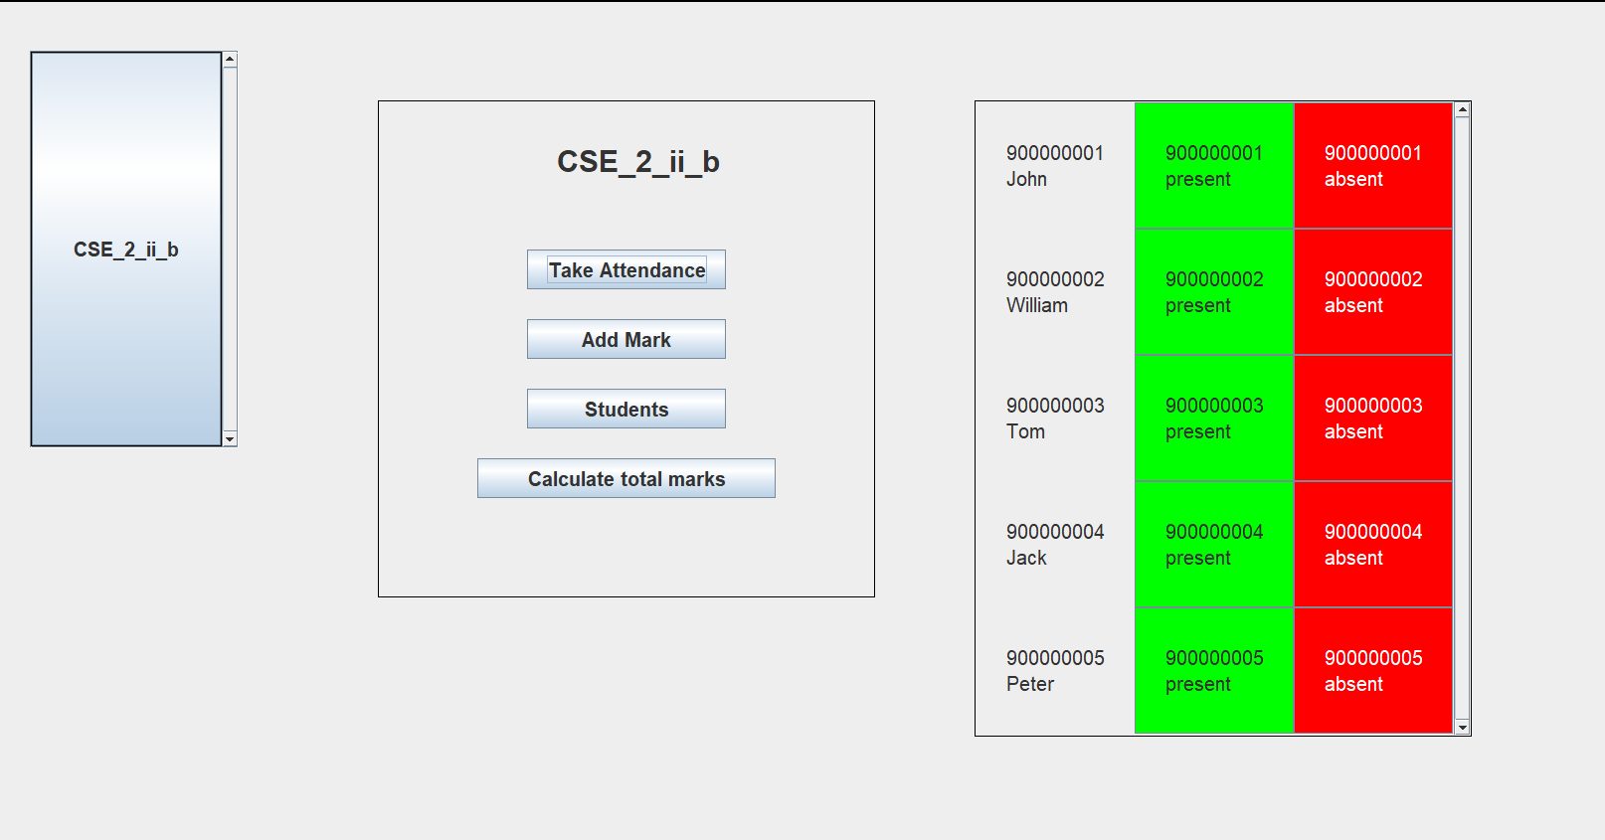
'Take Attendance' button works for collecting attendance. Clicking green button set a student 'Present' and red button set him 'Absent'.
If set 'Absent', date will be stored in database. In case of 'Present', it will increment 'number of classes he was present'.

Slide 11
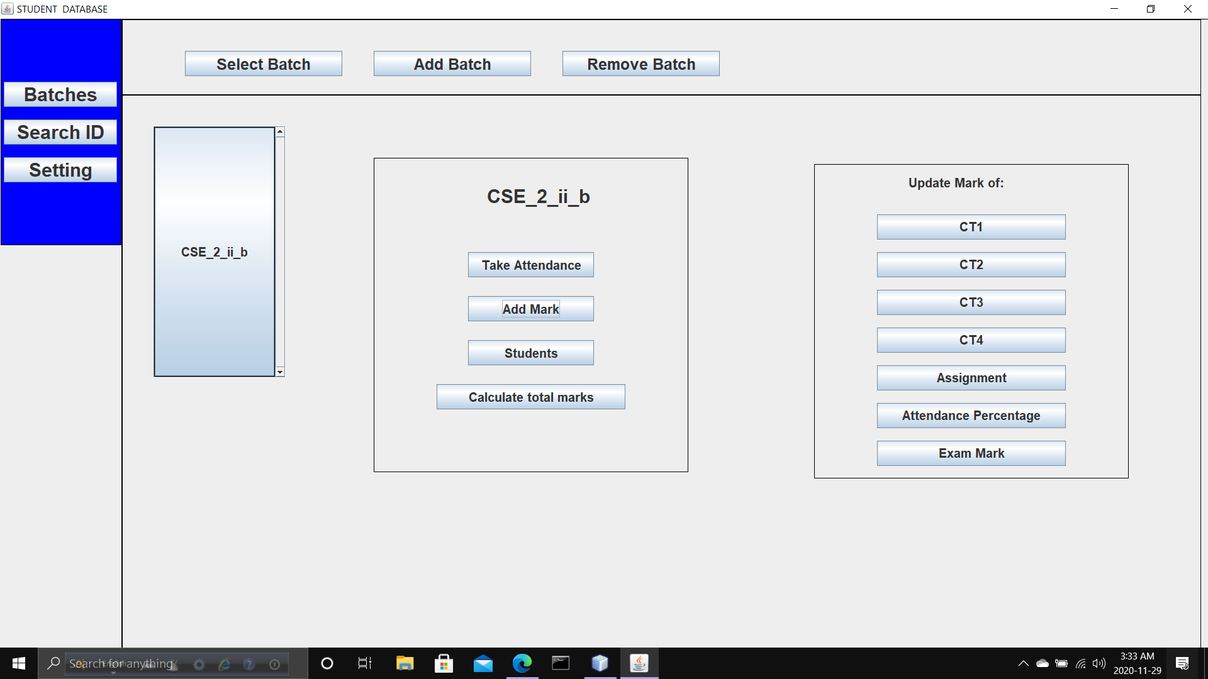
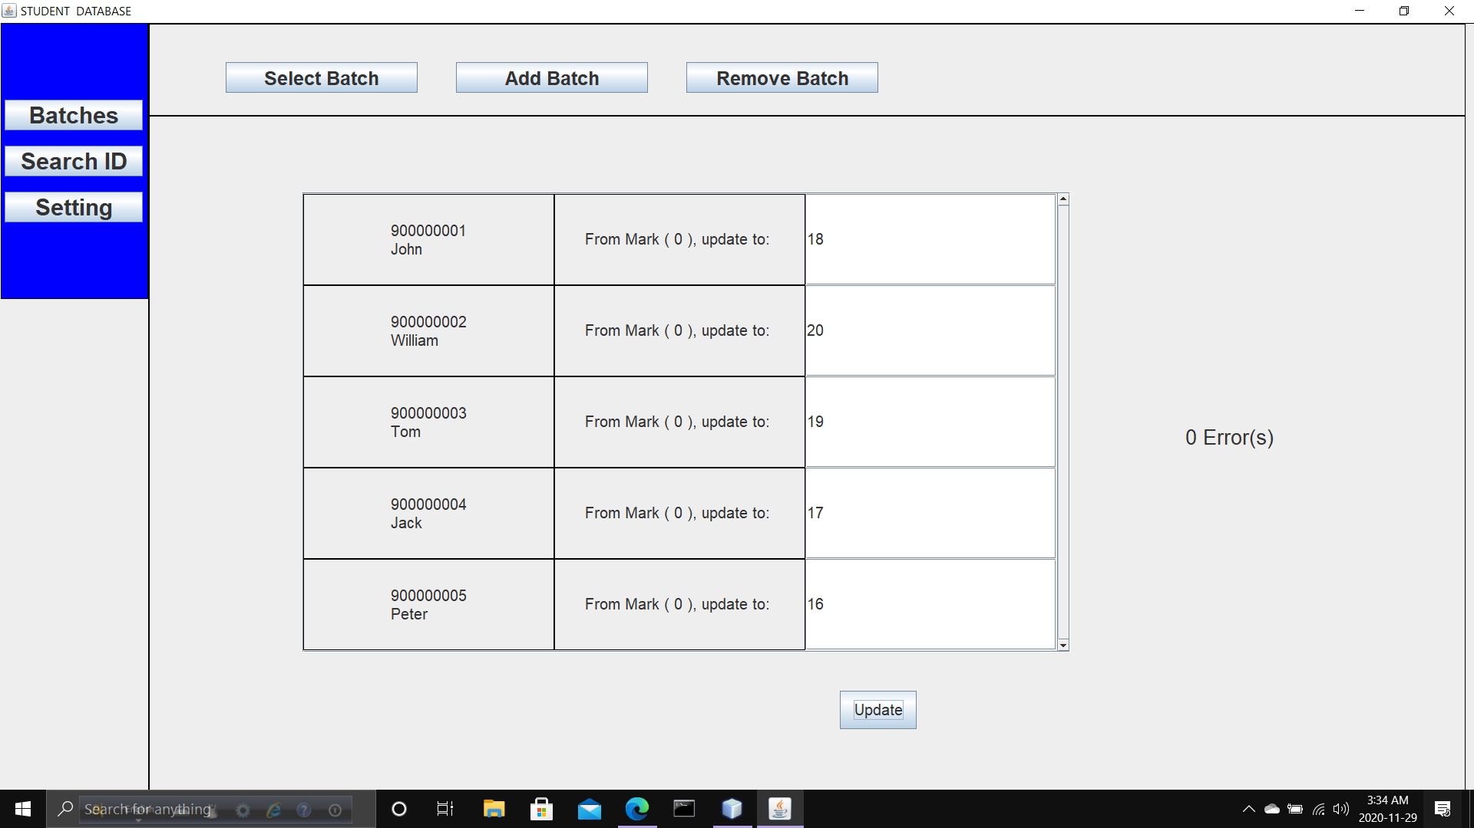
Inside 'Add Mark' button various marks_container(that contains marks. Such as CT1, CT2, ….) will be seen. Selecting a mark_container, marks of all student can be updated of that mark_container.

Slide 12
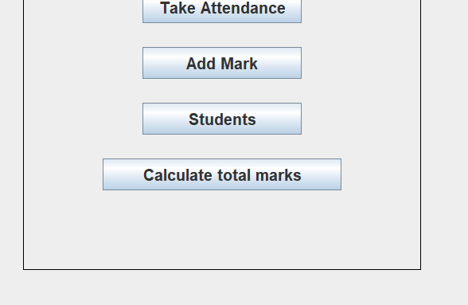
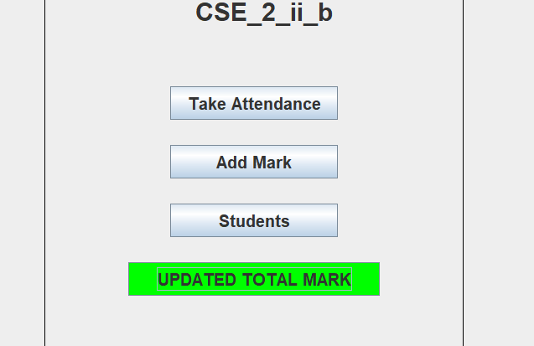
Clicking 'Calculate Total Mark' will add all marks of each students according to the rules are set.
Once calculating and updating is done, button 'Calculate Total Mark' will change its appearance.

Slide 13
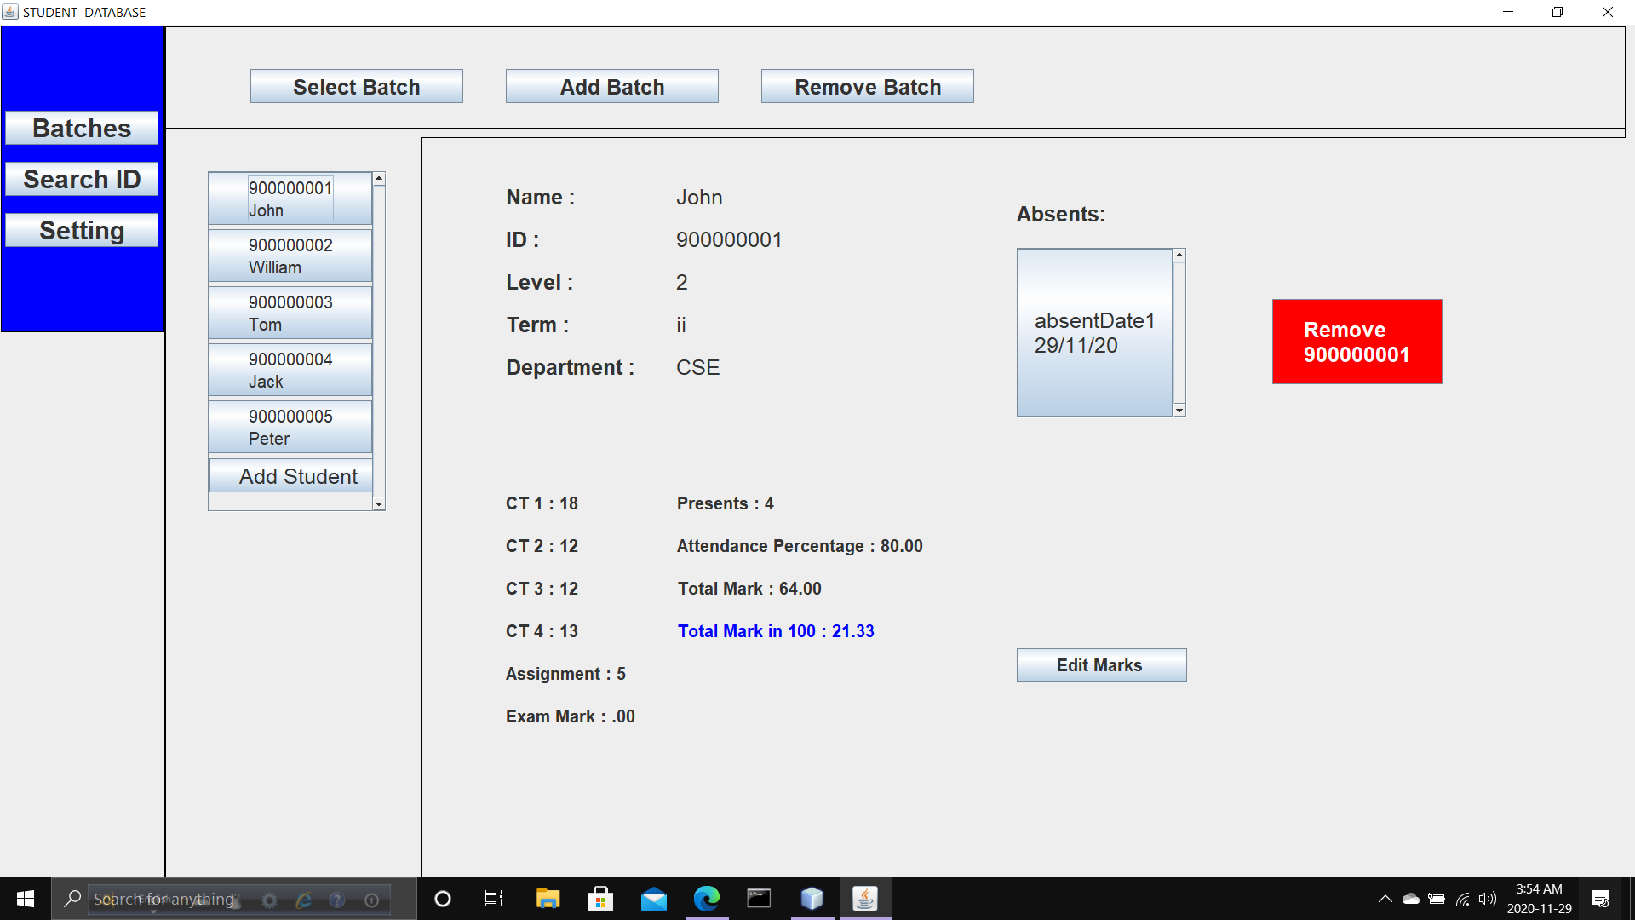
If we select a student from 'students' option, we can see information.

Slide 14
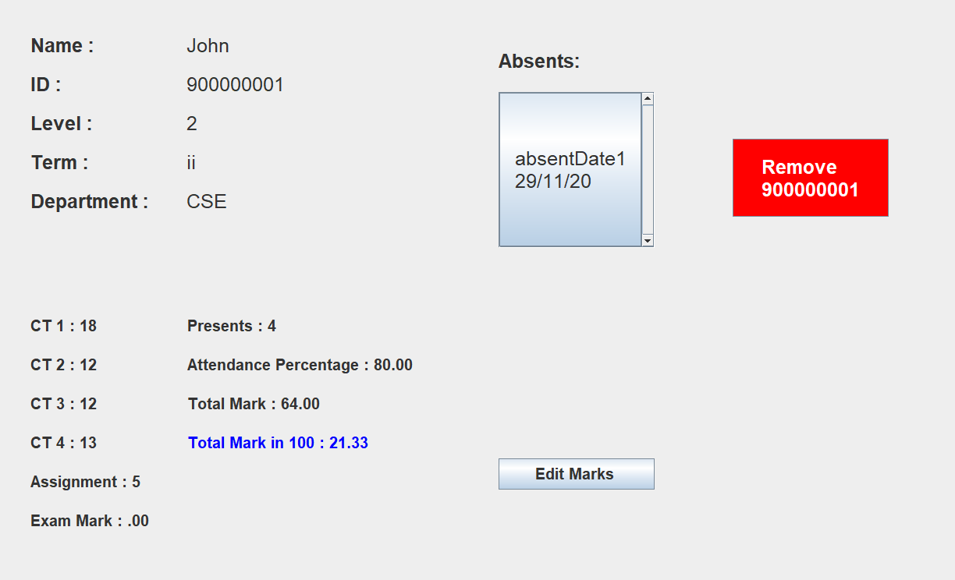
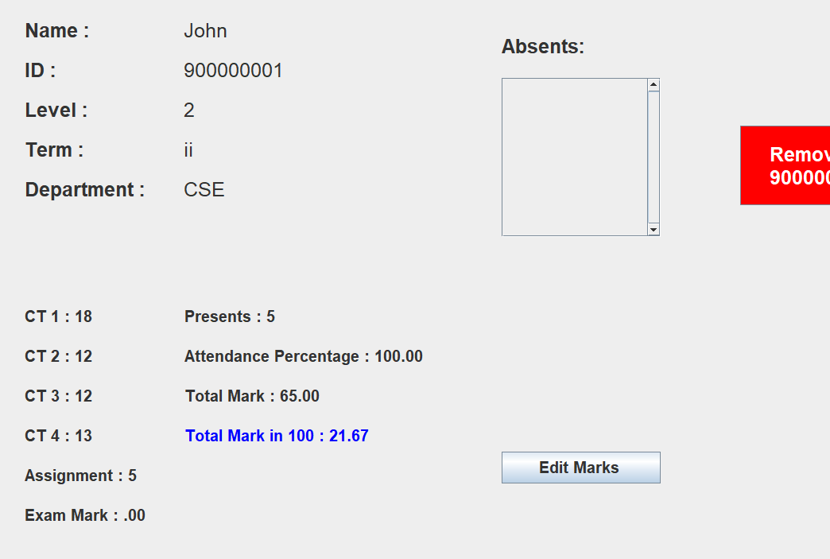
Clicking on a particular 'absent date' of the screen , that date will be disappeared from absent date and it will affect the attendance percentage. But, 'calculate total mark' button to be clicked again.

Slide 15
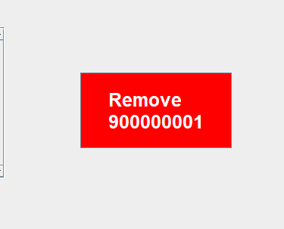
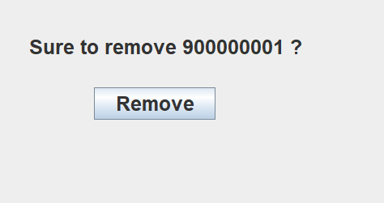
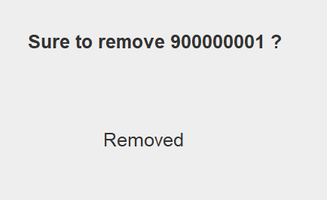
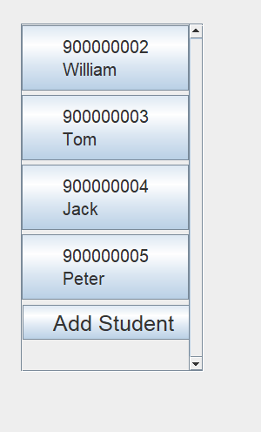
Clicking the 'Remove' button it is possible to remove the student of that id from database.

Slide 16
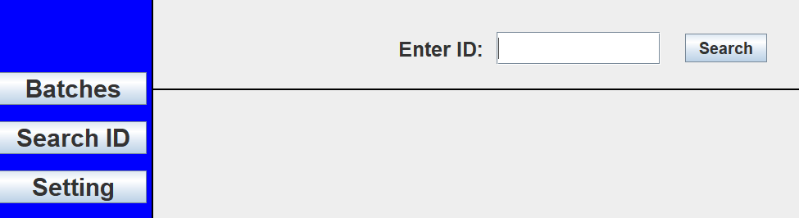
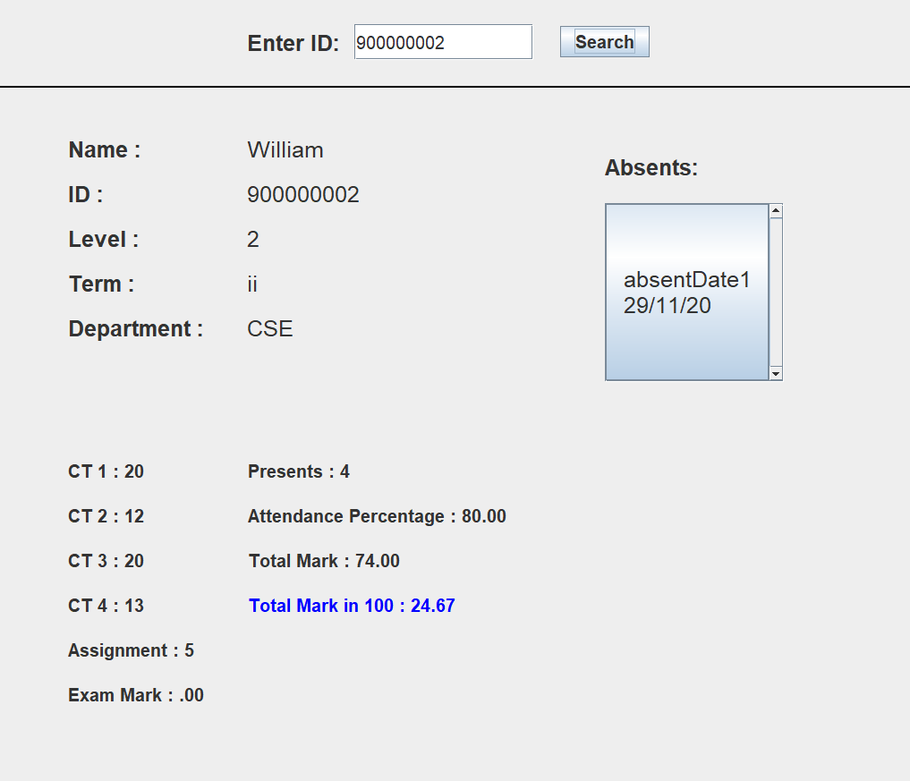
Clicking the 'Search ID' button it is possible to view students information. But updating is not allowed through this option.

Slide 17
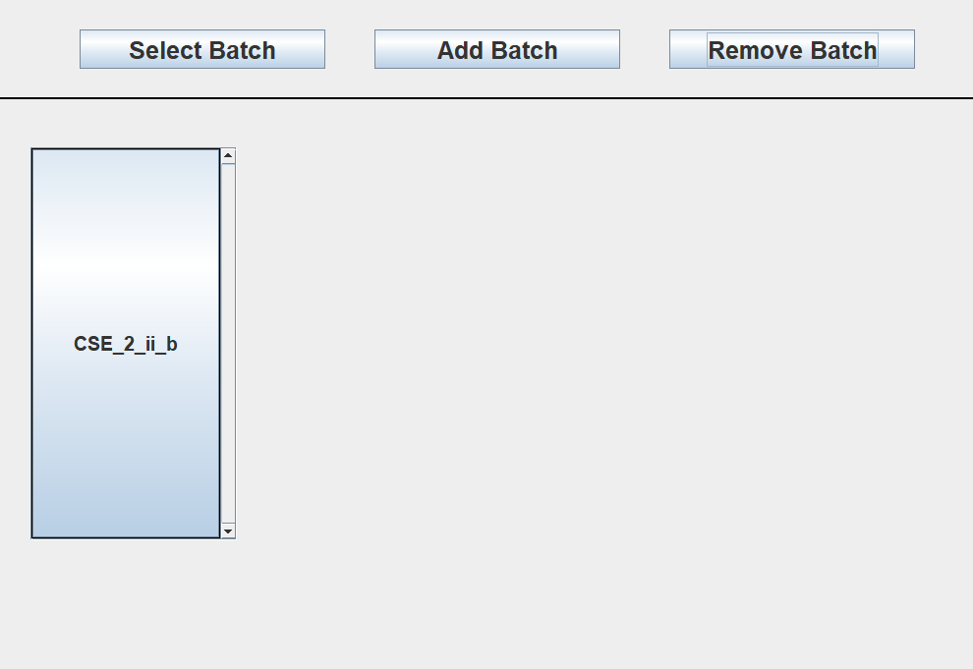
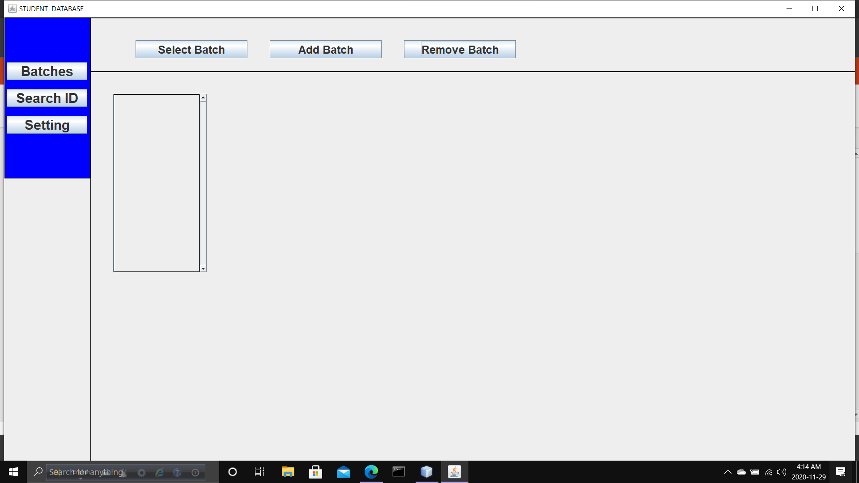
Clicking the 'Remove Batch' button we can remove a batch.

Slide 18
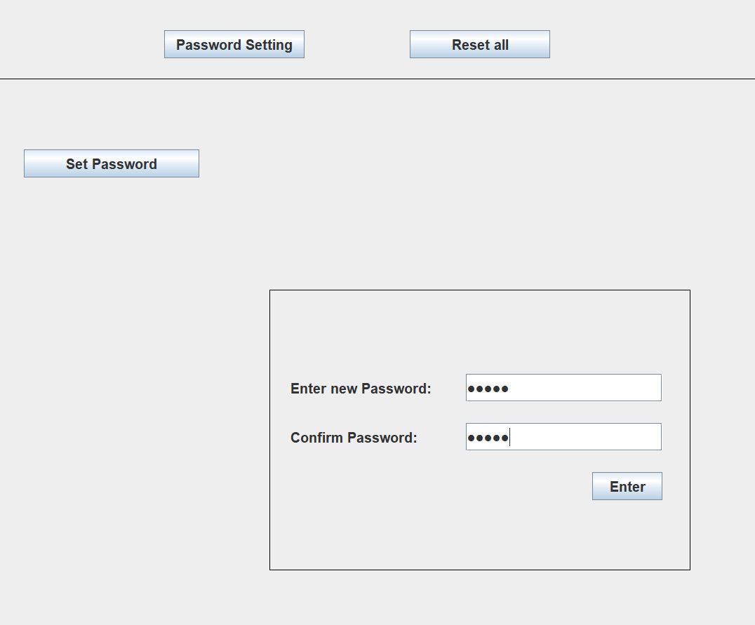
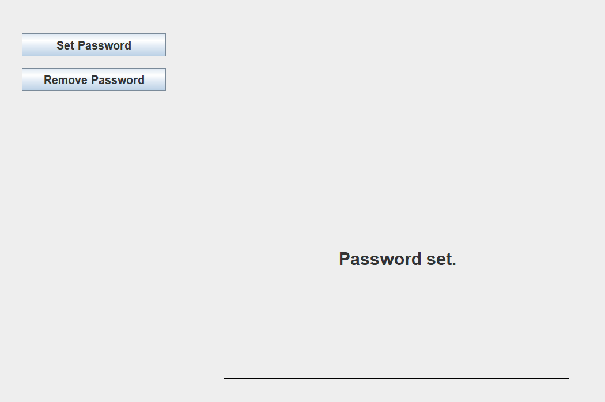
In case of 'setting' button we can set password, change password, reset the application.

Slide 19
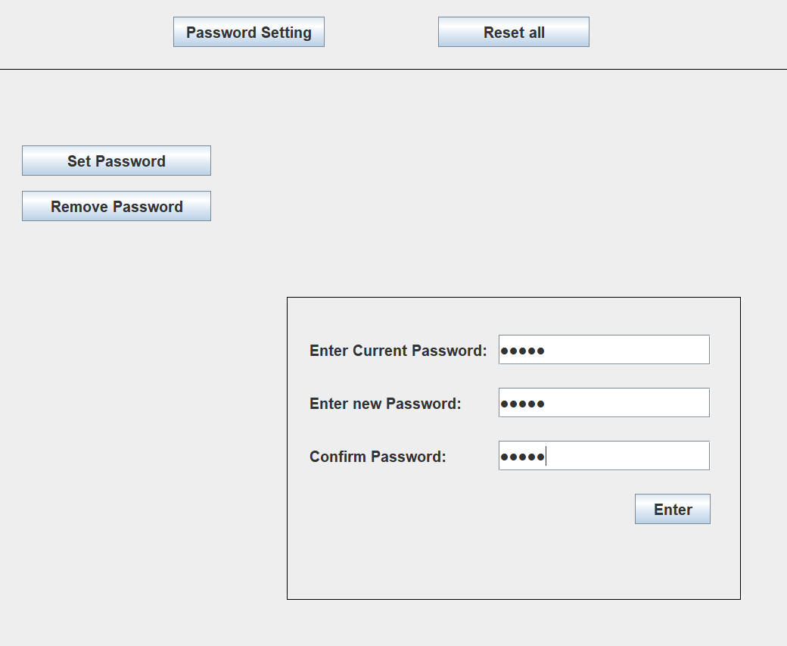
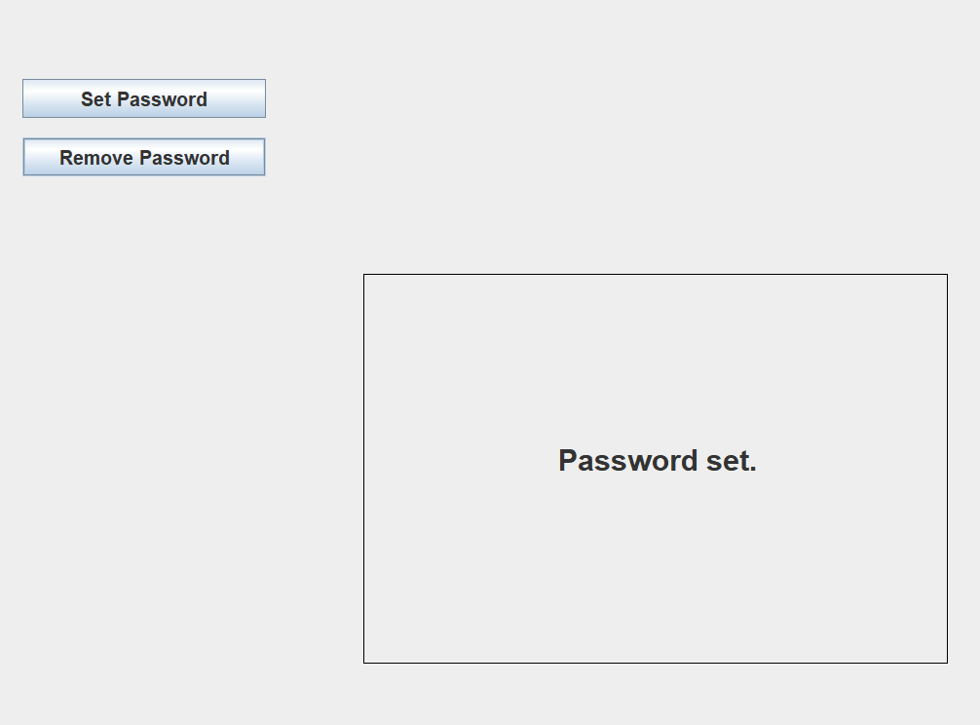
If already a password is set, 'set password' option will ask about current password.

Slide 20
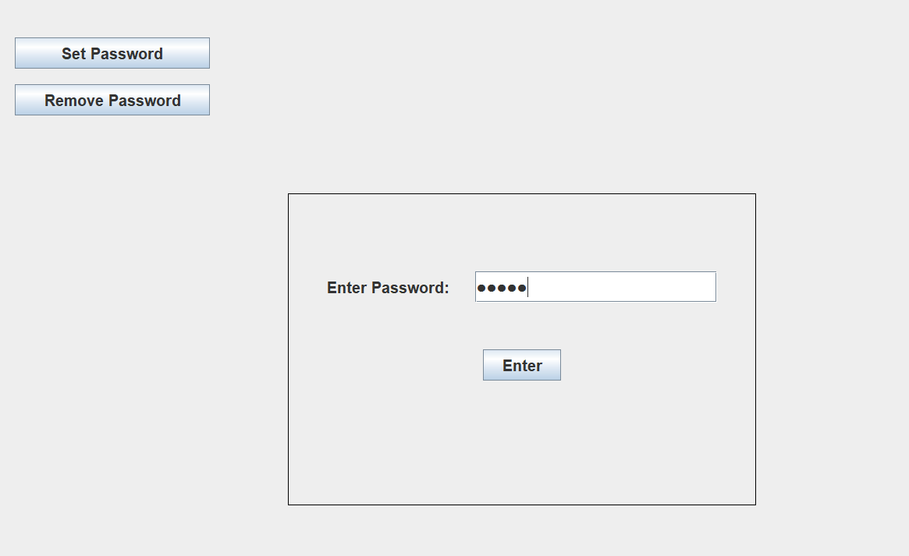
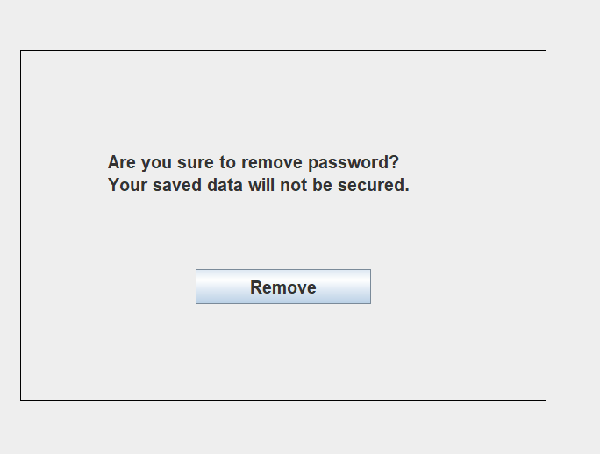
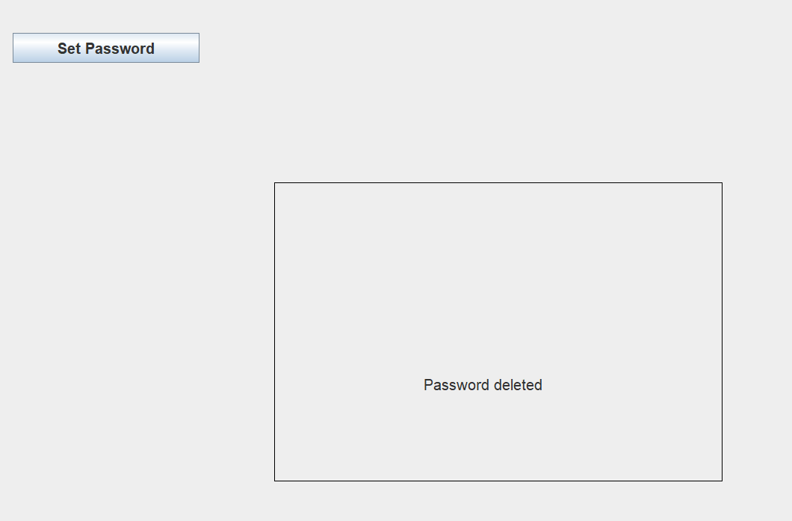
Password can be removed using current password.

Slide 21
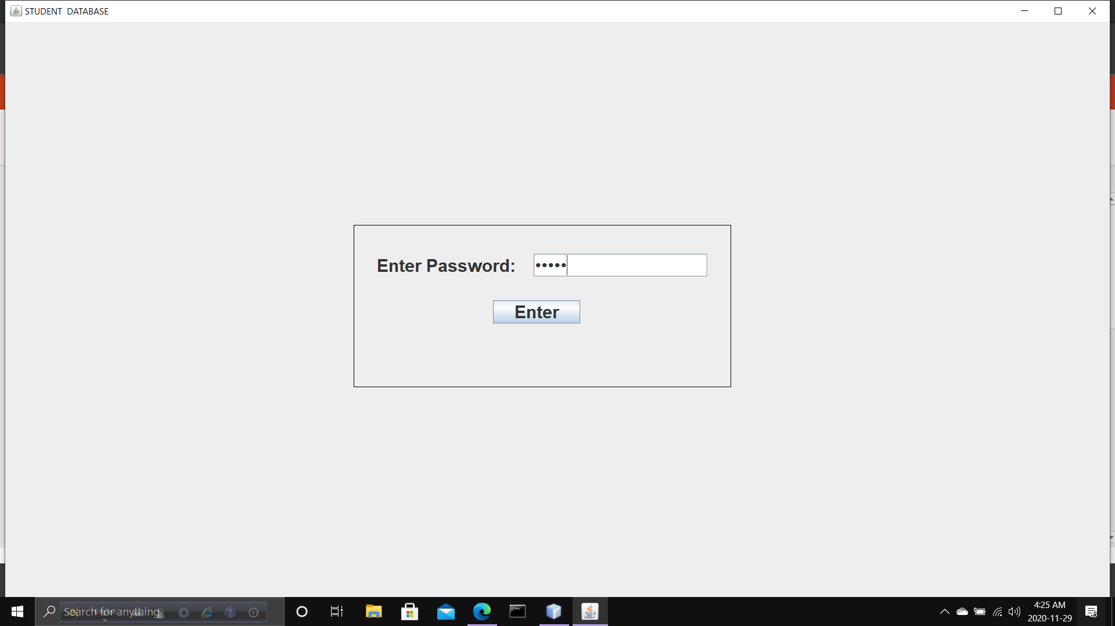

If password is set, it will ask the password at the time of opening the application.

Slide 22
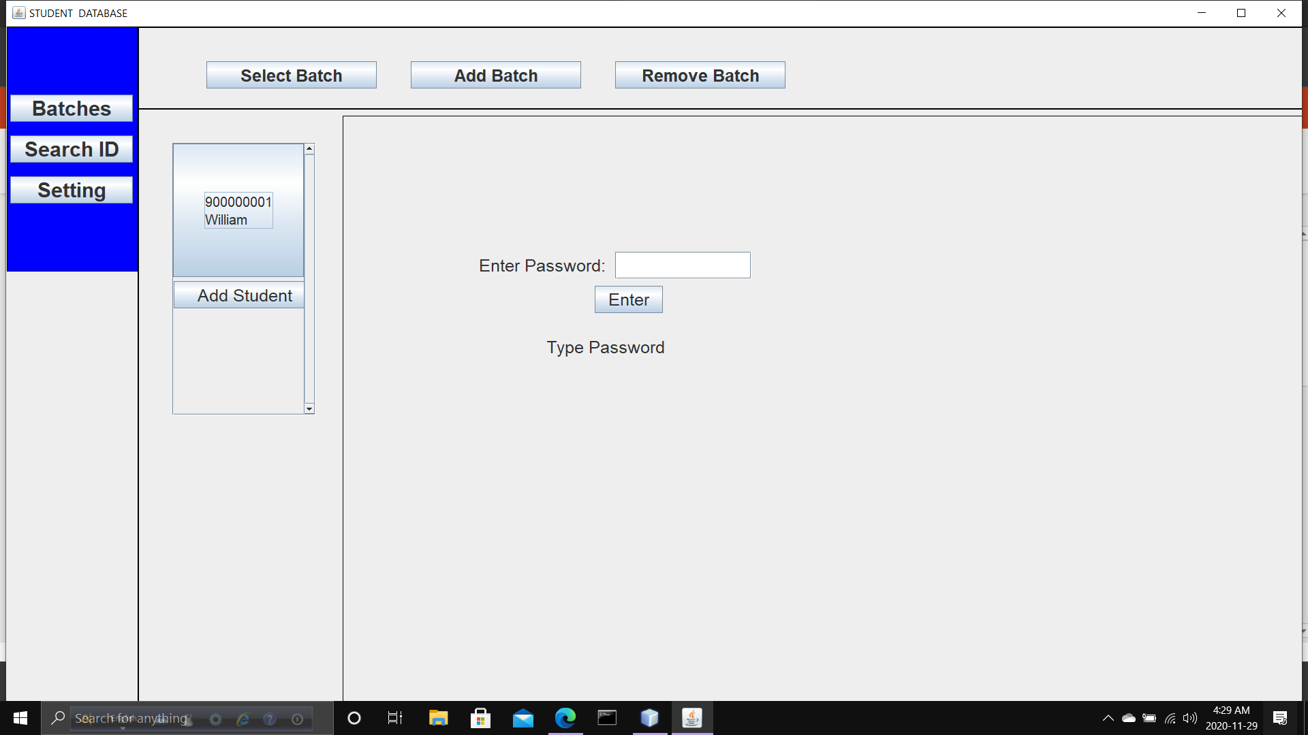
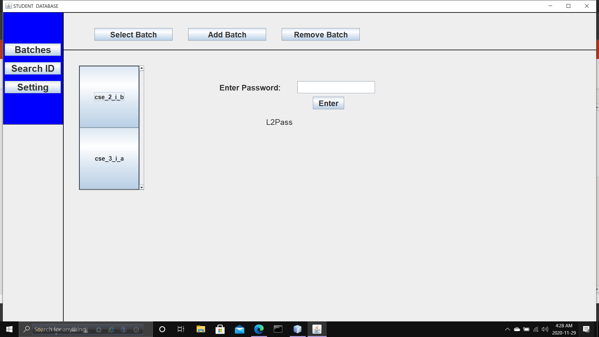
During removing batch, removing id it requires password.

Slide 23

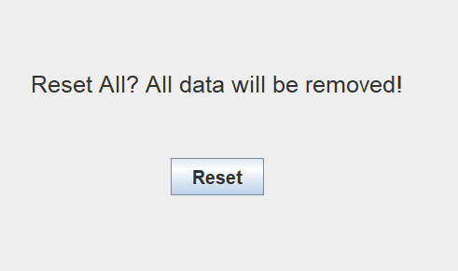

When it is about 'reset', it requires password if there is.

Slide 24
Thank you. That is all about the project. To get the code, click the link :
Student-Database/Student_database.java at main · Rageeb-Intisar-Polok/Student-Database (github.com)

